Slide 1
Web-scraping prices
ONS Big Data Project
Feb 2014

Slide 2
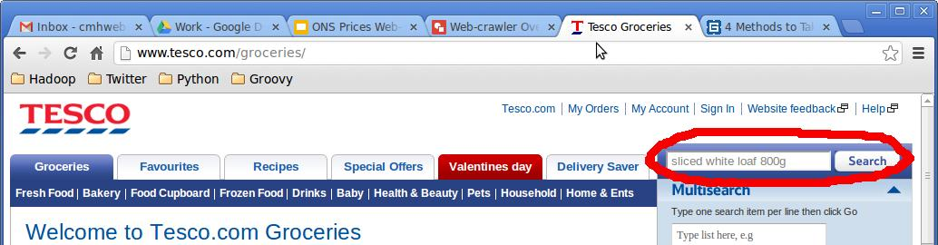
How much is a sliced loaf at Tesco?
How do you do this manually?
Go to Tesco’s website http://www.tesco.com/groceries/
Query for “sliced white loaf 800g”
Click “Search”

Slide 3
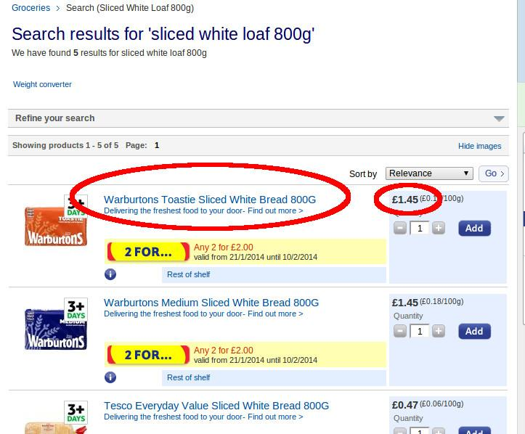
Now just look at the search results

Slide 4
How do we automate this process?
Need to know how to:
format a search query for Tesco’s website
submit a query request to Tesco’s website
fetch search results from Tesco’s website
find individual product items in results
extract product price information for each item
store these details so we can look at them later

Slide 5
So what is Tesco’s query format?
We want to search for “white sliced loaf 800g”.
Run this query manually on Tesco’s website to find out the query URL:
http://www.tesco.com/groceries/product/search/default.aspx?notepad=white%20sliced%20loaf%20800g
Break this up into main query URL…
http://www.tesco.com/groceries/product/search/default.aspx?notepad=
...and query parameters:
white%20sliced%20loaf%20800g
(“%20” is how URLs represent a single space)

Slide 6
So now we can build a query
Query Tesco’s for “white sliced loaf 800g”:
http://www.tesco.com/groceries/product/search/default.aspx?notepad=white%20sliced%20loaf%20800g
Query Tesco’s for “bacon 300g”:
http://www.tesco.com/groceries/product/search/default.aspx?notepad=bacon%20300g
Query Tesco’s for “butter 250g”:
http://www.tesco.com/groceries/product/search/default.aspx?notepad=butter%20250g
And so on…

Slide 7
So now we can build a query
Query Tesco’s for “white sliced loaf 800g”:
http://www.tesco.com/groceries/product/search/default.aspx?notepad=white%20sliced%20loaf%20800g
Query Tesco’s for “bacon 300g”:
http://www.tesco.com/groceries/product/search/default.aspx?notepad=bacon%20300g
Query Tesco’s for “butter 250g”:
http://www.tesco.com/groceries/product/search/default.aspx?notepad=butter%20250g
And so on…
...until Tesco’s changes how its website works!

Slide 8
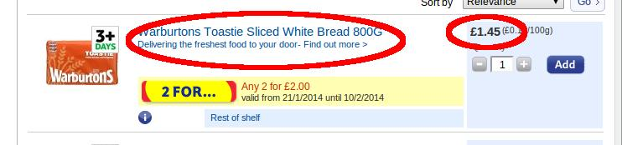
What about the search results?
Pretty obvious where to find the required information, right?

Slide 9
What about the search results?
Pretty obvious where to find the required information, right? WRONG!!!

Slide 10
What about the search results?
Can you find the price of a given product item?
......
</div><div class="productLists" id="endFacets-1"><ul class="cf products line"><li id="p-254942348-3" class=" first"><div class="desc"><h3 class="inBasketInfoContainer"><a id="h-254942348" href="/groceries/Product/Details/?id=254942348" class="si_pl_254942348-title"><span class="image"><img src="http://img.tesco.com/Groceries/pi/121\5010044000121\IDShot_90x90.jpg" alt="" /><!----></span>Warburtons Toastie Sliced White Bread 800G</a></h3><p class="limitedLife"><a href="http://www.tesco.com/groceries/zones/default.aspx?name=quality-and-freshness">Delivering the freshest food to your door- Find out more &gt;</a></p><div class="descContent"><!----><div class="promo"><a href="/groceries/SpecialOffers/SpecialOfferDetail/Default.aspx?promoId=A31234788" title="All products available for this offer" id="flyout-254942348-promo-A31234788--pos" class="promoFlyout"><span class="promoImgBox"><img src="/Groceries/UIAssets/I/Sites/Retail/Superstore/Online/Product/pos/2for.png" class="promoFlyout promo" alt="Special Offer" id="flyout-254942348-promo-A31234788--posimg" /></span><em>Any 2 for £2.00</em></a><span> valid from 21/1/2014 until 10/2/2014</span></div><div class="tools"><div class="moreInfo"><a href="/groceries/Product/Details/?id=254942348" class="midiFlyout" id="flyout-254942348-midi-0-"><img class="midiFlyout hd" src="http://ui.tescoassets.com/groceries/UIAssets/I/../Compressed/I_635209615845382232/Sites/Retail/Superstore/Online/Product/infoBlue.gif" alt="" title="View product information" id="flyout-254942348-midi-1-" /></a></div><!----><div class="links"><ul><li><a href="http://www.tesco.com/groceries/product/browse/default.aspx?notepad=white%20sliced%20loaf%20800g&amp;N=4294793217" class="shelfFlyout active plaintooltip" id="s-tt-254942348" title="Premium White Bread"> Rest of <span class="hide">Premium White Bread <!----></span>shelf </a></li></ul></div></div></div></div><div class="quantity"><div class="content addToBasket"><p class="price"><span class="linePrice">£1.45<!----></span><span class="linePriceAbbr"> (£0.18/100g)</span></p><h4 class="hide">Add to basket</h4><form method="post" id="fMultisearch-254942348"
.....

Slide 11
So can the computer do it for us?
Yes, but…
Each website processes queries and formats results differently, so we need to be able to modify our code accordingly.
Also, we want to minimise the amount of code we have to write - and maintain - in order to run this processing.
So we want to find a standardised approach that will use generic code/libraries wherever possible.
So what does this process look like?

Slide 12
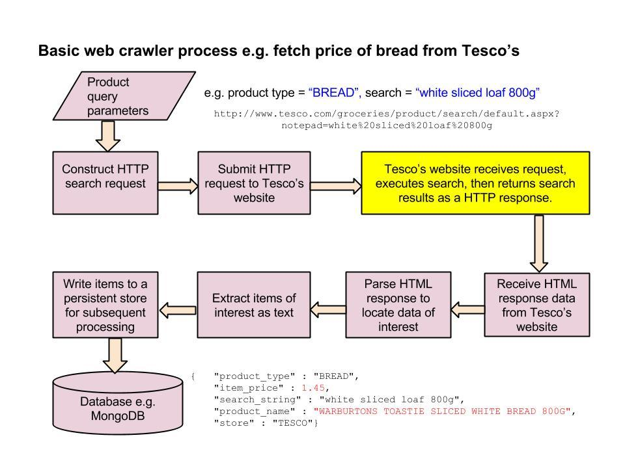
Web-scraping: overview

Slide 13
Tools for our web-scraping project
Python 2.7...

Slide 14
Tools for our web-scraping project
Python 2.7...
...because it’s powerful, flexible and widely used.

Slide 15
Tools for our web-scraping project
Python 2.7...
...because it’s powerful, flexible and widely used.
Scrapy...

Slide 16
Tools for our web-scraping project
Python 2.7...
...because it’s powerful, flexible and widely used.
Scrapy...
...because it’s a powerful, flexible and widely used web-scraping framework for Python.

Slide 17
Tools for our web-scraping project
Python 2.7...
...because it’s powerful, flexible and widely used.
Scrapy…
...because it’s a powerful, flexible and widely used web-scraping framework for Python.
MongoDB...

Slide 18
Tools for our web-scraping project
Python 2.7...
...because it’s powerful, flexible and widely used.
Scrapy…
...because it’s a powerful, flexible and widely used web-scraping framework for Python.
MongoDB…
...because it’s a powerful, flexible and widely used NoSQL database that works well with Python, allows easy integration with Scrapy, and provides a practical platform for subsequent exploration of the data.

Slide 19
Working with Scrapy
Scrapy generates a basic skeleton for a web-scraping project, including various configuration files.
Scrapy uses custom “spider” classes to crawl web pages.
The Scrapy spider generates a search request for the required website, and Scrapy submits the request.
When the results are received from the website, Scrapy passes them to the spider, which extracts the desired information from the results into “items”.
We can then decide how to process the items.

Slide 20
What do we ask Scrapy to look for?
We have written our own code to allow Scrapy to fetch the query search string from a CSV text file e.g.:
"product_type","qparams"
"DAIRY","semi-skimmed milk"
"DAIRY","butter 250g"
"MEAT","bacon 250g"
"BREAD","white sliced bread 800g"
"KITCHEN","kitchen towel 2"
Our custom spider constructs the search URLs from this data, and Scrapy submits the search requests to the target website e.g. Tesco’s.

Slide 21
What code do we have to write?
We have to implement a spider e.g. TescoSpider.
This includes a start_requests() method to construct the URLs for each query request.
The spider also includes a parse() method that uses XPath to find and extract data from the results received from Tesco’s website, returning them as Scrapy Items.
We create a separate TescoItem class to hold the product price data extracted from the search results.
The scrapy-mongodb tool provides extra config settings for Scrapy to write the items to MongoDB.

Slide 22
Our start_requests() method
def start_requests(self):
"""Generates crawler requests based on a set of target URLs.
Includes product type and original search string on request so we
can extract them from the response when creating items to store in
the database.
"""
targets = self.get_targets() # Our helper to build list of query URLs
for target in targets:
# Construct and return a Request for each URL
# We also include Product Type and Search String for later use
yield Request(url = target['url'],
meta={'product_type': target['prodtype'],
'search_string': target['search_string']},
callback=self.parse)

Slide 23
Our parse() method (uses XPath)
def parse(self, response):
"""Main parser method: Overrides Scrapy parser to parse each crawled response.
Extracts product type and original search string to include on items for queries etc."""
sel = Selector(response)
#Finds entries with class linePrice
sites = sel.xpath("//*[@class='cf products line']/li")
items = []
for site in sites:
# Add an item to the list for each linePrice
item = TescoItem()
item['product_type'] = response.meta['product_type']
item['search_string'] = response.meta['search_string']
item['store'] = "TESCO"
item['product_name'] = (site.xpath("*[@class='desc']/*/a[contains(@class,'title')]/text()").extract()[0]).upper()
# remove pound sign from price and convert to float
raw_price = site.xpath(
"*[@class='quantity']/div/p/span[@class='linePrice']/text()").extract()[0]
item['item_price'] = float(raw_price.strip(u'\xa3') )
items.append(item)
return items

Slide 24
What do our final results look like?
scrapy-mongodb writes each item as a separate JSON document to a MongoDB collection (table), automatically adding an ISO timestamp:
{ "_id" : ObjectId("52f4c568a7d406191b38bc46"),
"product_type" : "BREAD",
"item_price" : 0.47,
"search_string" : "white sliced bread 800g",
"scrapy-mongodb" : {
"ts" : ISODate("2014-02-07T11:37:12.479Z") },
"product_name" :
"TESCO EVERYDAY VALUE SLICED WHITE BREAD 800G",
"store" : "TESCO"}
This data is now available for query in MongoDB.

Slide 25
Today Tesco’s, tomorrow the world?
So far we have implemented a “walking skeleton” application that can scrape a small set of product prices off Tesco’s website and store them locally.
Clearly we need to implement more functionality

Slide 26
Today Tesco’s, tomorrow the world?
So far we have implemented a “walking skeleton” application that can scrape a small set of product prices off Tesco’s website and store them locally.
Clearly we need to implement more functionality e.g.:
Much wider range of products - also need to confirm we can query and identify products reliably.

Slide 27
Today Tesco’s, tomorrow the world?
So far we have implemented a “walking skeleton” application that can scrape a small set of product prices off Tesco’s website and store them locally.
Clearly we need to implement more functionality e.g.:
Much wider range of products - also need to confirm we can query and identify products reliably.
Other stores - need new Scrapy spider for each store as each website will work differently.

Slide 28
Today Tesco’s, tomorrow the world?
So far we have implemented a “walking skeleton” application that can scrape a small set of product prices off Tesco’s website and store them locally.
Clearly we need to implement more functionality e.g.:
Much wider range of products - also need to confirm we can query and identify products reliably.
Other stores - need new Scrapy spider for each store as each website will work differently.
Clarify minimum set of product price data we want to acquire, and how to make it available to analysts.

Slide 29
Still plenty of work to do!
Extend our prototype and make it more robust.
Establish standard format for storing scraped price data to make analysis easier.
Scale up/out to more realistic data volumes.
Identify suitable data storage platform e.g. flat files, MongoDB, relational database.
Identify suitable tools or languages for data cleansing and analysis e.g. Python, Java, R, SAS etc.
Demonstrate ability to produce useful outputs from web-scraped pricing data.
Identify other suitable use cases for this approach vs existing formal data sources.

Slide 30
Further information
Scrapy at a glance:
http://doc.scrapy.org/en/latest/intro/overview.html
MongoDB:
http://www.mongodb.org/about/introduction/
Free online training in MongoDB for Python/Java developers or for DBAs:
https://education.mongodb.com/courses
scrapy-mongodb pipeline:
http://sebastiandahlgren.se/2013/01/07/mongodb-pipeline-for-scrapy/

Slide 31
Questions?

